Slide 1


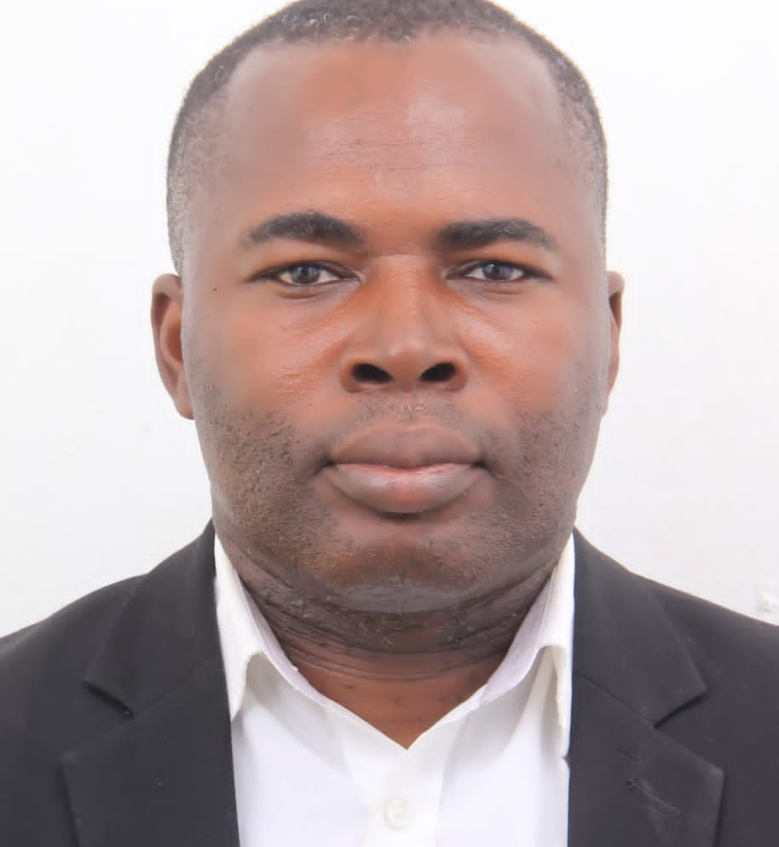
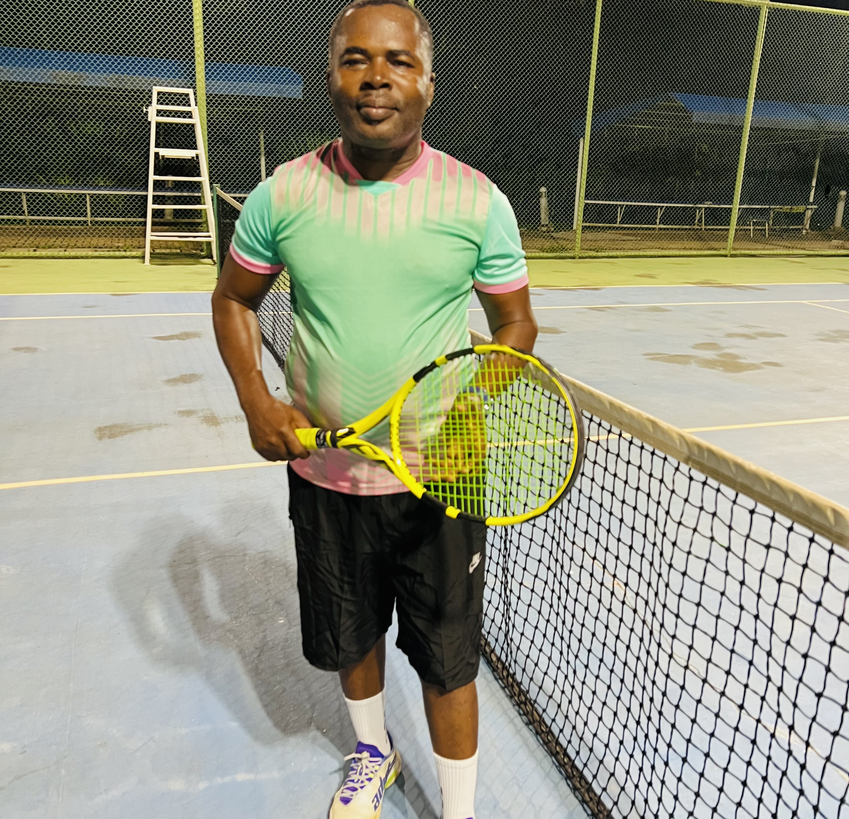
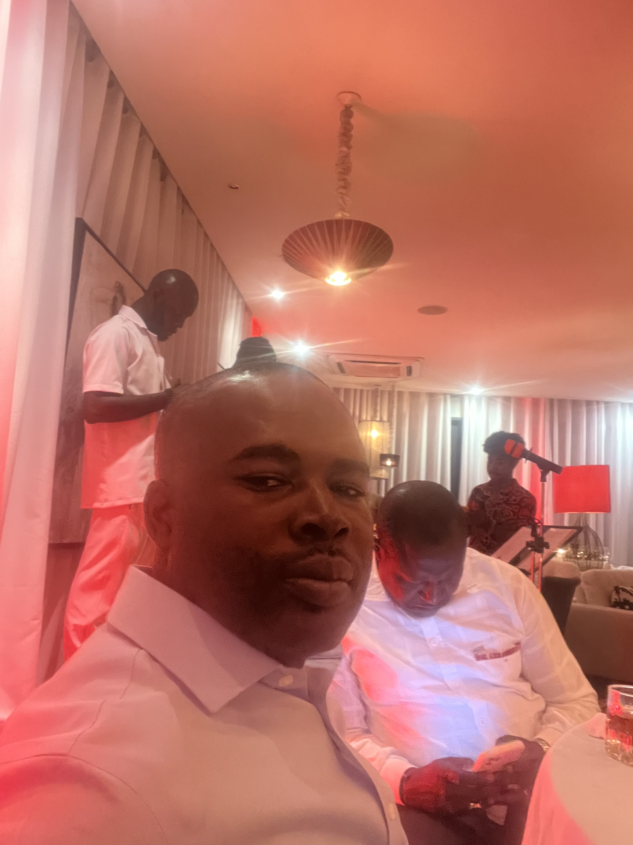
Getting to Know Me
Work
Personal
My role
Finance Manager
Significant others / family members / furry friends in my life
Married with Two Daughters
Tenure in ofi/Olam
23yrs
How I enjoy spending my free time
Playing lawn Tennis, Time with Family, Backyard Farming and being alone in quiet places.
Previous companies I have worked at
Taysec Construction Ltd & PBC
My favorite / comfort food
Banku with Fried Fish and hot Pepper
Why I joined ofi/Olam and what keeps me here?
Global Presence and the opportunity to grow career/talent and to help Contribute to realizing the overall vision. I have never regretted joining ofi/Olam. It has been very rewarding, Motivating , learnings and re-learning.
My favorite song
“Iron sharpen Iron” and “Behold” by Culture.
Ishmael Ninson
Ishmael
A few fun facts about me
Love listening to reggae music, Dance to good music and chilling out with Friends.
This is me outside work, doing stuff I enjoy in my life …

